Slide 1
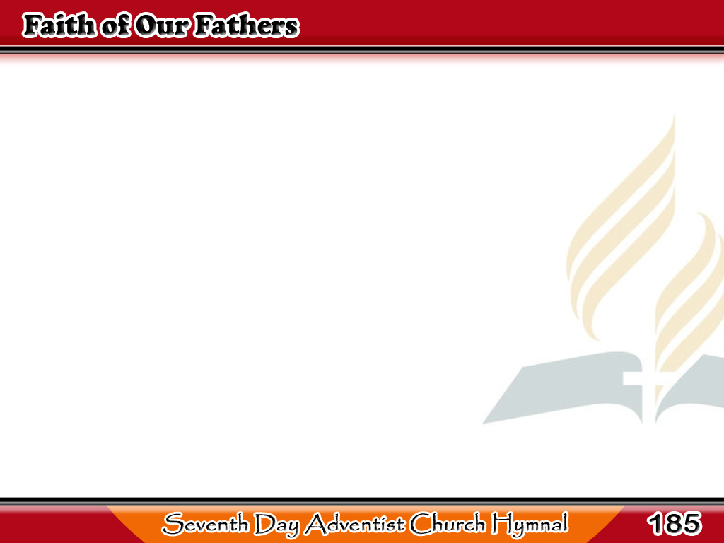
Ang Pananampalataya ng Ating mga Magulang
Faith of our fathers! living still
In spite of dungeon,
fire, and sword,
O how our hearts beat
high with joy
1/3

Slide 2
Ang Pananampalataya ng Ating mga Magulang
Whene’er we hear
that glorious word.
Faith of our fathers! holy faith!
We will be true to thee till death.
1/3

Slide 3
Ang Pananampalataya ng Ating mga Magulang
Our fathers, chained
in prisons dark,
Were still in heart
2/3

Slide 4
Ang Pananampalataya ng Ating mga Magulang
and conscience free;
How sweet would be
their children’s fate,
2/3

Slide 5
Ang Pananampalataya ng Ating mga Magulang
If they, like them,
could die for thee!
Faith of our father! holy faith!
We will be true to thee till death.
2/3

Slide 6
Ang Pananampalataya ng Ating mga Magulang
Faith of our fathers!
we will love
Both friend and foe
3/3

Slide 7
Ang Pananampalataya ng Ating mga Magulang
in all our strife,
And preach thee,
too, as love knows how,
3/3

Slide 8
Ang Pananampalataya ng Ating mga Magulang
By kindly words and virtuous life.
Faith of our fathers! holy faith!
We will be true to thee till death.
3/3

